Slide 1
SAGE’s National LGBT Elder Housing Initiative Navigating the Needs of LGBT Elders in Housing During Today’s Climate
Presented by
Sydney kopp-Richardson
Notes:
We stand in an exciting time, as following SAGE’s participation in the PinkNews Ageing Summit in May, we see that folks in the UK and other players are looking to SAGE as the world experts in LGBT elder housing, so this initiative is moving forward with deep excitement and building collaborations worldwide on best practices and competencies.

Slide 2
Guiding Thought What is one word symbolizing “home”?
Copyright ©2019, SAGE, All Rights Reserved
Notes:
Introductions: Turn to a partner and answer these questions for three minutes. Name, gender pronouns, one word that comes to mind when you think of “home” Share-back with a few volunteers, 2 minutes.

Slide 3
A Bit About Me…
Director of National LGBT Elder Housing
Pronouns: she/her
Midwestern, queer, white, cisgender woman
Committed to leverage my own privileges and experiences to elevate the voices of our communities
Work in reverence to our community, ancestors, and to those who create beauty in the margins
Copyright ©2019, SAGE, All Rights Reserved
Notes:
From Chicago to Los Angeles to NYC, my work for the past 15 years has been in direct service, organizing, and policy advocacy with a history of work in HIV and mental health, housing and homelessness, and LGBTQ anti-violence work with a focus on deeply vulnerable communities.

Slide 4
National LGBT Elder Housing Initiative
Building Housing
Training Providers
Changing Policy
Educating Consumers
Expanding Services
Copyright ©2019, SAGE, All Rights Reserved
Notes:
We know that affordability and safety is a challenge for our communities as we age, so the NHI works to provide T.A. and public education around developing safe, affirming housing nationally, serving as a model for best practices and a resource for region-specific advocates, service providers, developers, and our communities.
The SAGE National LGBT Elder Housing Iniative asks communities to imagine a NEW Reality. The Iniative is a multi-year project with 5 key actions designed to ensure millions of LGBT older people can access welcoming LGBT housing in all its forms. The keys to the Iniative include:
Building Housing – SAGE will invest in building model LGBT elder housing in select communities while sharing our model nationwide to create more LGBT elder housing. Two developments are currently underway in New York City.
Changing Policy - SAGE is actively working to change public policy to both the federal and state level in support of LGBT-inclusive housing.
Educating Consumers – SAGE equips LGBT older adults with tools and resources they need to advocacy for LGBT friendly housing. This includes a searchable map
Expanding Services – SAGE will promote best practices in services and programs that support LGBT older people with their housing challenges.
Training Providers – SAGE will training housing providers nationwide on the needs of LGBT older people. This training is developed and delivered through the SAGECare training team.

Slide 5
SAGE’s National Housing Initiative
Assist communities in developing LGBT-welcoming housing
1. Provides Culturally competent services
2. Welcoming community of peers and allies
3. Affordability is taken into consideration
Aging-in-place best practices provide alternatives for communities unable to galvanize political will or that do not have economies of scale.
Cultural Competency training for staff of all affordable housing, assisted living/nursing homes serving LGBT aging older adults.
Notes:
Create a continuum of housing interventions for LGBT older adults. Whether it is providing cultural competency training to mainstream affordable housing providers, creating LGBT-friendly affordable senior buildings or accessing the tools to safely age in place and engage in supportive community supports, the purpose of the initiative is to create a welcoming environment and provide choice to LGBT older adults to self-select the option that best fits their individual desires and needs.

Slide 6
What is “LGBT-Affirming”?

Slide 7
What is “LGBT-Affirming”? Housing that provides a welcoming environment of community, peers, and allies, often including voluntary culturally competent services, with affordability taken into account.

Slide 8
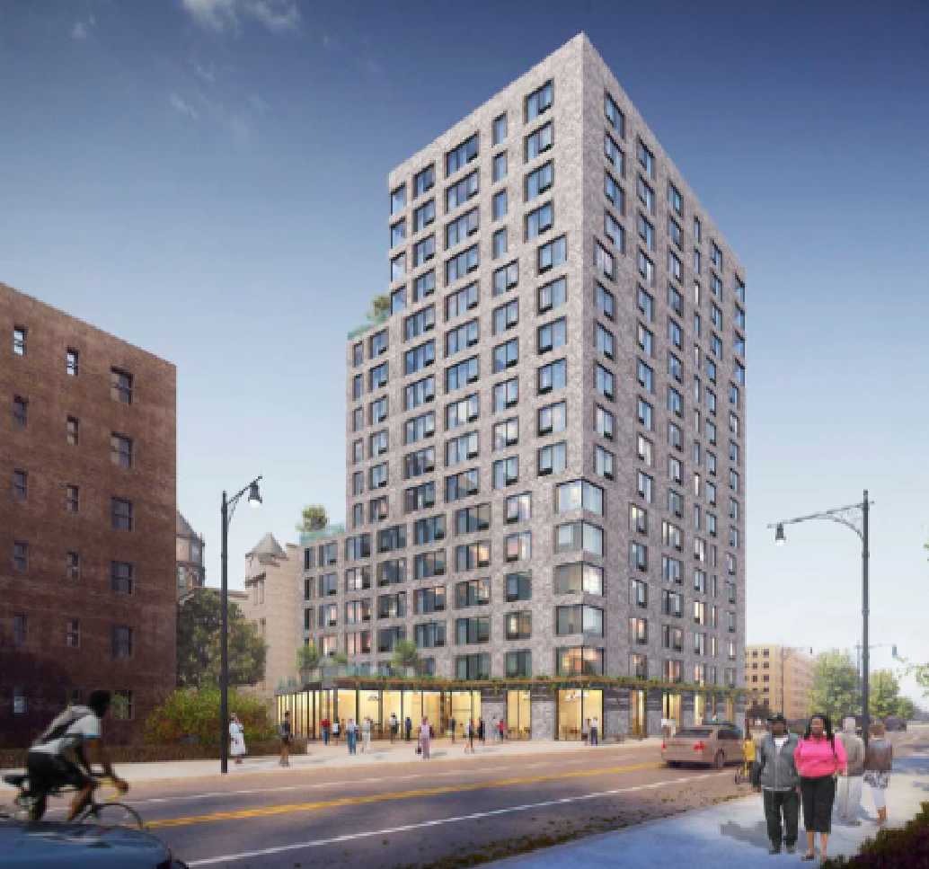
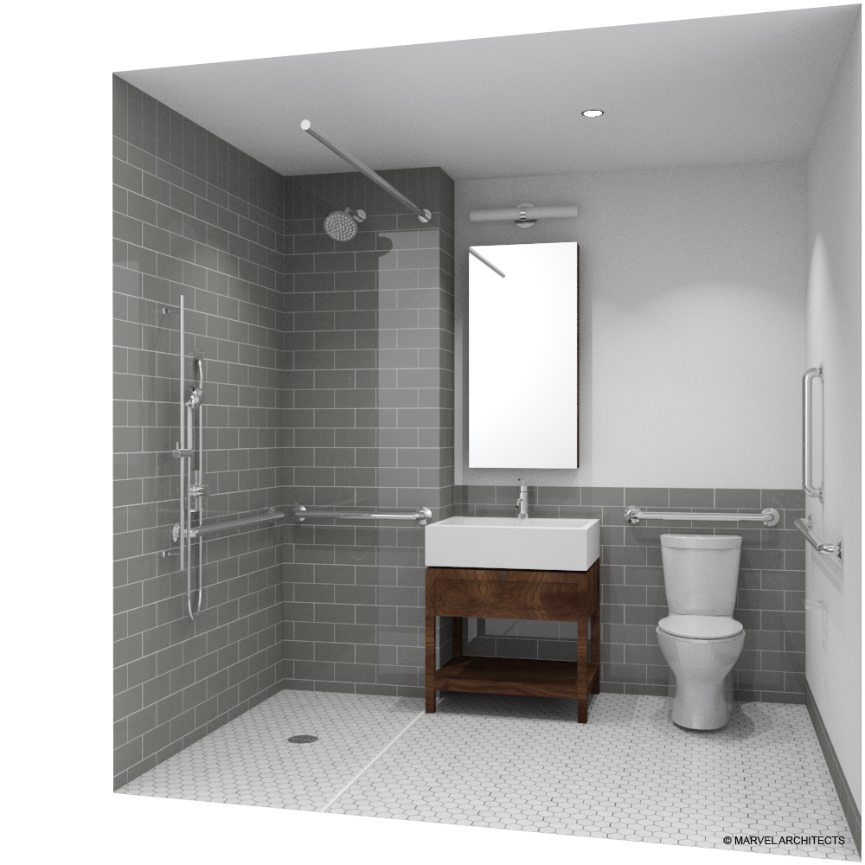
SAGE has opened New York’s first LGBT-affirming affordable housing residence in Brooklyn: Stonewall House.

Slide 9
Homes should be our havens, safe enough to be ourselves
as LGBTQ people—especially as we age.
Challenges
Economic
Insecurity
Housing Discrimination
Lack of Legal Protections
Racial & Gender Disparities
Notes:
Some of the most identified challenged for our LGBT aging older adults revolve around their housing settings. Issues pertaining to economic security, housing discrimination and feeling safe and protected in their home environments often face LGBT communities as they age.

Slide 10
The Facts
48% of same-sex older adults say they have experienced housing discrimination
Out and Visible: The Experiences and Attitudes of Lesbian, Gay, Bisexual
and Transgender Older Adults, Ages 45-75. http://www.sageusa.org/
© SAGE (Services and Advocacy for GLBT Elders) 2017

Slide 11
The Facts
1 in 4 transgender older adults reports discrimination when seeking housing.
Out and Visible: The Experiences and Attitudes of Lesbian, Gay, Bisexual
and Transgender Older Adults, Ages 45-75. http://www.sageusa.org/
© SAGE (Services and Advocacy for GLBT Elders) 2017
Notes:
We still have very limited data on TGNCNB elders, but the lack of data IS the data and speaks to the need

Slide 12
Equity and Inclusion: Anti-Oppression Framework
© SAGE (Services and Advocacy for GLBT Elders) 2016
Notes:
I’m going to talk about a few examples of how we infuse equity and inclusion into our technical assistance, through the lens of intersectionality and anti-oppression.(Defined by Kimberle Crenshaw).
Intersectionality means that we are all a combination of different traits or identities, such as culture, ethnicity race, education, age, language, and also sexual orientation and gender identity. Oppression, very loosely defined, is a pattern or system of inequality that gives power and privileges to one group of people at the expense of another (GLSEN). It is the combination of PREJUDICE (negative beliefs about a group of people) plus POWER (Capacity to make and enforce decisions, including access to social and economic systems, groups, or individuals who own and control resources of governing bodies). Oppression is: Ableism, sexism, racism, Islamaphobia, classism, heterosexism, transphobia, etc). It can be interpersonal, cultural, institutional, and internalized. An anti-oppression lens is intended to dismantle systems that maintain this type of inequity and oppression. For me, this means Ally vs. spokesperson; Access and leverage my own privileges so others don’t have to educate people on their own oppression; that does not mean that I am a spokesperson for communities that I am not a part of.
Example of anti-oppression centering our technical assistance: 1. Shelter systems systematically exclude trans people, and this is exacerbated by the Federal movement to further criminalize and erase the identities of trans people, particularly in shelter. Our advocacy involves fighting both these policies and these violent narratives of who trans people are, and identify the ways this exclusion further excludes trans communities from accessing housing (“system touch” as a way to track vulnerability and need and collect data). 2. SAGE’s leadership has resulted in NYCHA agreeing to change their intake forms and include “non-binary” as a gender category, which is a monumental shift and can serve as a best practice for national housing providers and social service providers as they develop their own programs and processes.
3. Outreach for housing—what organizations and communities are we reaching? And who are we not, and why? (Are the orgs centering whiteness? Do we need to do outreach in places of worship as sites of POC community building? Etc)

Slide 13
What might be some barriers LGBT elders face in accessing housing?

Slide 14
Barriers to Housing for LGBT Elders
Family of origin rejection
Isolation, exploitation
Discrimination
Housing protections
Economic marginalization
Health care
Landlords
Intimate partner violence, elder abuse
Shelter access and safety
Notes:
• Bio family rejection/loss—lack of familial support compared to straight and cisgender counterparts
• Isolation—Some people have no support circle, or may have once but now as elders their community is gone
• Discrimination—GENDA passed in NY, but a lifetime of discrimination exacerbates barriers to accessing what is needed to meet basic needs (still no protection under Fair Housing Law)
o Housing: LGBT folks are not protected under the Fair Housing Act of 1968
o Economic marginalization
▪ Often the LGBT community, especially transgender communities, experience lower levels of income due to historic inequities of pay and blatant hiring discrimination in the workplace.
▪ No protection against job discrimination might mean no employment history on the books, or engagement in underground economy that has no regulation
▪ Wealth and access beget wealth—poverty is much harder to move from when you have no support
o Health care: Lack of non-traumatizing medical services lead to long-term/chronic health challenges)
o Landlords—not only discrimination, but harassment, sexual violence, lack of intervention when supers or neighbors commit harm
o IPV—what does a “survivor” and “perpetrator” look like? Unique patterns of power and control in LGBTQ relationships (ie: economic abuse if a person has no support system; controlling gender presentation, hiding medications, manipulating privilege such as whiteness or cisgender identity to villainize the survivor when authorities are called, police will often arrest the more feminine presenting person if an arrest is required).
o Shelter as a point of “access,” but many people choose streets/couches over shelter (“couch surfing” is not a legal homeless definition, disqualifying access to services/housing for homeless folks)

Slide 15
COVID-19 Impact COVID-19 has exacerbated barriers and vulnerability due to both health/immunity challenges, compounded by systemic discrimination and barriers we just discussed
Social isolation
Mental and cognitive health decline
Food insecurity
Generalized fear and anxiety
Notes:
• COVID-19 has exacerbated barriers and vulnerability due to both health/immunity challenges, compounded by systemic discrimination and barriers to support listed above
o WHAT WE ARE SEEING
▪ Food scarcity
▪ Mental health decline
▪ Isolation
▪ Poverty
▪ Extreme loneliness
▪ Vulnerability to predatory exploitation

Slide 16
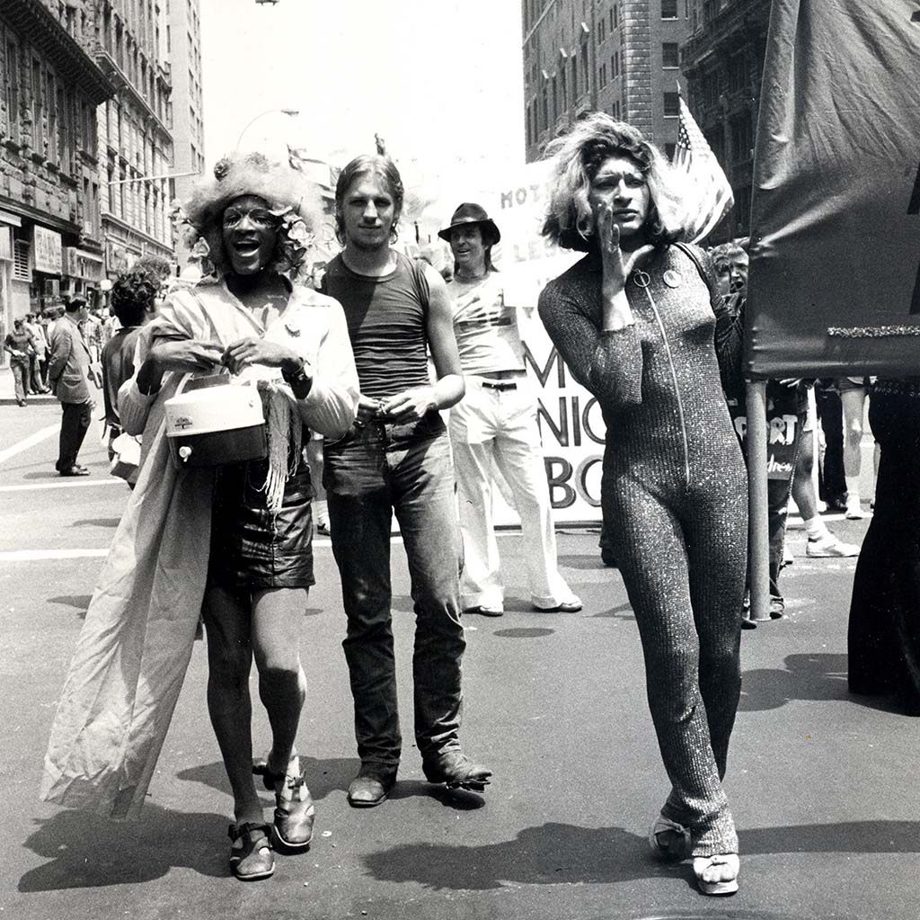
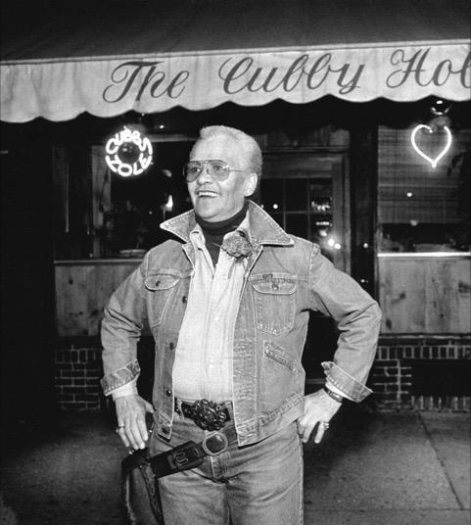
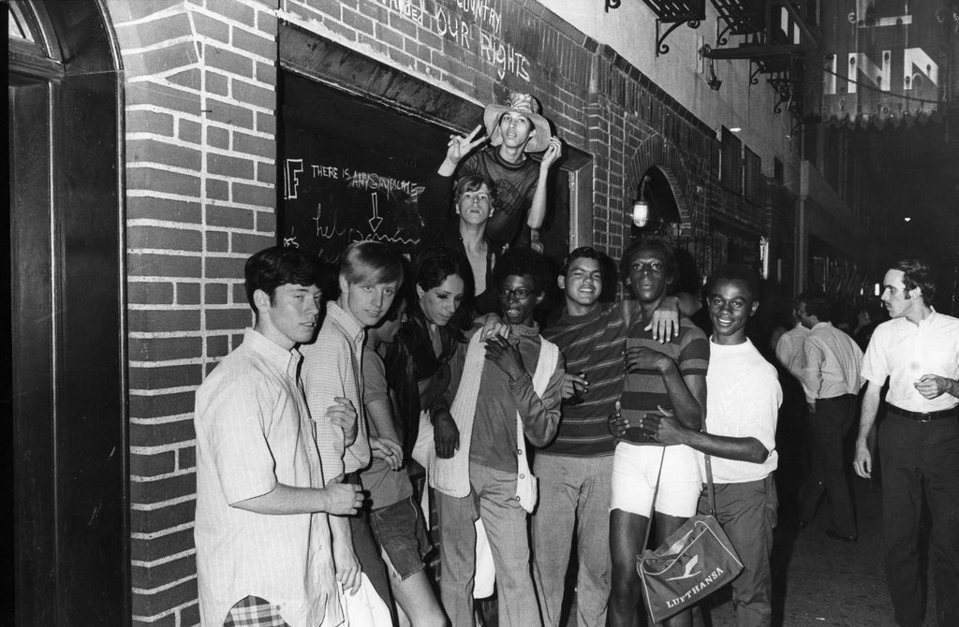
Pride Means Knowing Our History Stonewall was a riot led by predominantly trans people, LGBTQ people of color, and folks struggling with housing, poverty, and police violence.

Slide 17
What is SAGE doing to support elders in housing?
Stonewall House engagement and support
SAGEConnect and COVID callers
Food delivery
Notes:
SAGEConnect
Stonewall House
Tenant Association implementation
Weekly wellness check-ins and food delivery
Intensive direct service calls
Connecting to resources and social opportunities
Development of virtual community space
Crisis intervention
Delivering PPE
Outreach and COVID callers
Food delivery
Context of COVID-19, potential for humanizing and more people who would normally not interact are, and people are waking up more with more time and thought and vulnerability

Slide 18
Criminalization in the Current Climate
Cannot talk about community health without connecting the Movement for Black Lives and COVID to the criminalization that occurs in health systems
Collective memory and trigger of HIV epidemic, loss, survival guilt, and community grief
Who is criminalized?
Whose safety is taken into account, and whose is erased? How is “safety” loaded?
Disproportionate use of excessive force
Militarized response to a public health crisis, targeting people of color
Notes:
We cannot talk about disparity without talking about criminalization
At a time when LGBT elders are some of the population at the most intensive risk, due to both health vulnerability and compounded vulnerability due to disparities that already exist, we would be remiss not to connect this to the activism and Black Lives Matter Movement
I ask all of you the question: Who is criminalized in a public health paradigm?
We are seeing striking similarities to the criminalization of HIV that is happening in specific communities of color in the name of “community safety”
When I was a Ryan White Case Manager in the early to mid 2000s, we had clients sign forms that acknowledged that non-disclosure of HIV status is a criminal offense—this is one example of the ways people living with HIV were criminalized, when really the trauma-informed and holistic and humanizing approach to public safety is education, awareness, harm reduction
What we see right now amidst COVID is encouragement to call police or 311—who usually send police—to folks who are not wearing masks
We also see the disproportionate use of excessive police force against people of color in response to not wearing masks, juxtaposed next to the images we see of white folks gathering in large groups across the country
We see the difference in policing against Black Lives Matter activists than the groups of white folks mobilizing to open the country up again in the name of civil liberties
The community trauma of living through the HIV epidemic is resurfacing for many LGBT elders at this moment—from Stonewall being a riot against police violence, to the criminalization of HIV, to the ways that now policing continues to be a response to gaps in mental and public health systems
If we want to talk about collective resilience and how to support LGBT elders in the time of COVID, we must have an intersectional approach that understands the community trauma rooted in the criminalization of people in housing, discrimintation in housing, and the connection of housing to systems of povery INC, including the systemic use of force against certain communities, particularly Black communities
In this moment, I want us to recognize not only the needs of LGBT elders in housing in relation to poverty and safety, but specifically the needs of Black LGBT elders in housing, as these types of barriers and militarized responses to poverty feel incredibly cyclical

Slide 19
Role of Advocates
Protect and fight for policy protections that help ensure safety at the Federal and local levels
Amend Fair Housing Act to include LGBTQ protections
Pass the Equality Act, with consideration for housing protections
Trans and gender non-conforming specific protection are needed in this climate, with a note on deepest vulnerability and housing specific to the needs of transgender communities
Notes:
One of the roles of advocates right now is to protect and fight for policy protections that help ensure safety at the Federal and local levels
“Safety” can be a relative term—what does safety mean? Safety for whom? What feels safe for me, a 38-year-old white middle class cisgender woman, might not feel safe for an LGBT elder, particularly an elder of color
We must fight for protections that include racial justice and transgender justice
Examples of policy protections include:
Amend the Fair Housing Act to include LGBTQ explicit protections—an LGBT Elder Case for Fair Housing
Pass the Equality Act, with considerations for housing protections The Equality Act is a bill in the United States Congress, that, if passed, would amend the Civil Rights Act to prohibit discrimination on the basis of sexual orientation and gender identity in employment, housing, public accommodations, public education, federal funding, credit, and the jury system.
TGNC-specific protections, looking at the deepest vulnerability, in systems like the NYC CAPS system vulnerability assessment or carve-outs for trans-specific housing resources

Slide 20
Thank you for your time and energy! Questions & Follow Up?
Sydney Kopp-Richardson Director, National LGBT Elder Housing Initiative skopprichardson@sageusa.org 929.484.4176
Notes:
Thank you for you attention and time and energy—I am sending each of you warmth and appreciation during this difficult time, in hope for lasting systemic and social change.

